Slide 1
Generating job to a run stored procedure in SQL Server
By Surinthip Sakphoowadon

Slide 2
ETL Project Steps
ETL Process : From TPS_Sales to DW_Sales
Source: TPS_Sales
Destination: DW_Sales

Slide 3
TPS
Data warehouse

Slide 4
คำสั่ง Create data warehouse
CREATE TABLE [dbo].[Customer](
[Cust_Id] [nvarchar](20) NOT NULL,
[Prefix] [nvarchar](20) NULL,
[Cust_Name] [nvarchar](50) NULL,
[Cust_Surname] [nvarchar](60) NULL,
[Province] [nvarchar](50) NULL,
[Country] [nvarchar](50) NULL
) ON [PRIMARY]
GO

Slide 5
Product
CREATE TABLE [dbo].[Product](
[Product_Id] [nvarchar](20) NOT NULL,
[Product_NameEng] [nvarchar](50) NULL,
[Product_NameThai] [nvarchar](50) NULL,
[Unit_Type] [nvarchar](10) NULL,
[Unit_Price] [float] NULL,
[Balance_Qty] [float] NULL,
[Product_TypeId] [nvarchar](20) NULL
) ON [PRIMARY]
GO

Slide 6
Product_Type
CREATE TABLE [dbo].[Product_Type](
[Product_TypeId] [nvarchar](10) NOT NULL,
[Product_TypeName] [nvarchar](50) NULL
) ON [PRIMARY]
GO

Slide 7
Sales
CREATE TABLE [dbo].[Sales](
[Receipt_No] [nvarchar](20) NOT NULL,
[Cust_Id] [nvarchar](10) NULL,
[SDate] [nvarchar](10) NULL,
[Shop_no] [nvarchar](50) NULL,
[Emp_No] [nvarchar](20) NULL,
[Commission] [float] NULL
) ON [PRIMARY]
GO

Slide 8
Sales_Detail
CREATE TABLE [dbo].[Sales_Detail](
[Receipt_No] [nvarchar](20) NOT NULL,
[Product_Id] [nvarchar](20) NOT NULL,
[Sale_Qty] [int] NULL,
[Unit_Price] [float] NULL,
[Total_Amt] [float] NULL
) ON [PRIMARY]
GO

Slide 9
Shop
CREATE TABLE [dbo].[Shop](
[Shop_No] [nvarchar](10) NOT NULL,
[Shop_Name] [nvarchar](50) NULL,
[Province] [nvarchar](50) NULL,
[Country] [nvarchar](50) NULL
) ON [PRIMARY]
GO

Slide 10
insert into DW_SalesSystem66.dbo.Customer(Cust_Id,Prefix,Cust_Name,Cust_Surname,Province,Country)
select Cust_Id,Prefix,Cust_Name,Cust_Surname,Province,Country from SalesSystem.dbo.Customer
insert into DW_SalesSystem66.dbo.Product
select * from SalesSystem.dbo.Product
insert into DW_SalesSystem66.dbo.Product_Type
select * from SalesSystem.dbo.Product_Type
insert into DW_SalesSystem66.dbo.Sales(Receipt_No,SDate,Cust_Id,Shop_no,Emp_No,Commission)
select Receipt_No,SDate,Cust_Id,Shop_no,Emp_No,Commission from SalesSystem.dbo.Sales
insert into DW_SalesSystem66.dbo.Sales_detail(Receipt_No,Product_Id,Sale_Qty,Unit_Price,Total_Amt)
select Receipt_No,Product_Id,Sale_Qty,Unit_Price,Total_Amt from SalesSystem.dbo.Sales_detail
insert into DW_SalesSystem66.dbo.Shop(Shop_No,Shop_Name,Province,Country)
select Shop_No,Shop_Name,Province,Country from SalesSystem.dbo.Shop

Slide 11
Store Procedure
CREATE PROCEDURE [dbo].[ETLDataToDW]
@RMessage VARCHAR(500) OUTPUT
AS
BEGIN
BEGIN TRANSACTION
BEGIN TRY
insert into DW_SalesSystem66.dbo.Customer(Cust_Id,Prefix,Cust_Name,Cust_Surname,Province,Country)
select Cust_Id,Prefix,Cust_Name,Cust_Surname,Province,Country from SalesSystem.dbo.Customer
insert into DW_SalesSystem66.dbo.Product
select * from SalesSystem.dbo.Product
insert into DW_SalesSystem66.dbo.Product_Type
select * from SalesSystem.dbo.Product_Type
insert into DW_SalesSystem66.dbo.Sales(Receipt_No,SDate,Cust_Id,Shop_no,Emp_No,Commission)
select Receipt_No,SDate,Cust_Id,Shop_no,Emp_No,Commission from SalesSystem.dbo.Sales
insert into DW_SalesSystem66.dbo.Sales_detail(Receipt_No,Product_Id,Sale_Qty,Unit_Price,Total_Amt)
select Receipt_No,Product_Id,Sale_Qty,Unit_Price,Total_Amt from SalesSystem.dbo.Sales_detail
insert into DW_SalesSystem66.dbo.Shop(Shop_No,Shop_Name,Province,Country)
select Shop_No,Shop_Name,Province,Country from SalesSystem.dbo.Shop
SET @RMessage = 'Insert Data Successfully';
COMMIT
END TRY
BEGIN CATCH
ROLLBACK
SELECT @RMessage = ERROR_MESSAGE();
END CATCH
END
GO

Slide 12
CREATE PROCEDURE [dbo].[ETLDataToDW_nomsg]
AS
BEGIN
BEGIN TRANSACTION
BEGIN TRY
insert into DW_SalesSystem66.dbo.Customer(Cust_Id,Prefix,Cust_Name,Cust_Surname,Province,Country)
select Cust_Id,Prefix,Cust_Name,Cust_Surname,Province,Country from SalesSystem.dbo.Customer
insert into DW_SalesSystem66.dbo.Product
select * from SalesSystem.dbo.Product
insert into DW_SalesSystem66.dbo.Product_Type
select * from SalesSystem.dbo.Product_Type
insert into DW_SalesSystem66.dbo.Sales(Receipt_No,SDate,Cust_Id,Shop_no,Emp_No,Commission)
select Receipt_No,SDate,Cust_Id,Shop_no,Emp_No,Commission from SalesSystem.dbo.Sales
insert into DW_SalesSystem66.dbo.Sales_detail(Receipt_No,Product_Id,Sale_Qty,Unit_Price,Total_Amt)
select Receipt_No,Product_Id,Sale_Qty,Unit_Price,Total_Amt from SalesSystem.dbo.Sales_detail
insert into DW_SalesSystem66.dbo.Shop(Shop_No,Shop_Name,Province,Country)
select Shop_No,Shop_Name,Province,Country from SalesSystem.dbo.Shop
COMMIT
END TRY
BEGIN CATCH
ROLLBACK
END CATCH
END
GO
EXEC ETLDataToDW_nomsg

Slide 13
คำสั่งสำหรับเช็คผลลัพธ์
delete from DW_SalesSystem66.dbo.Customer
delete from DW_SalesSystem66.dbo.Product
delete from DW_SalesSystem66.dbo.Product_Type
delete from DW_SalesSystem66.dbo.Sales
delete from DW_SalesSystem66.dbo.Sales_detail
delete from DW_SalesSystem66.dbo.Shop
select * from DW_SalesSystem66.dbo.Customer
select * from DW_SalesSystem66.dbo.Product
select * from DW_SalesSystem66.dbo.Product_Type
select * from DW_SalesSystem66.dbo.Sales
select * from DW_SalesSystem66.dbo.Sales_detail
select * from DW_SalesSystem66.dbo.Shop

Slide 14
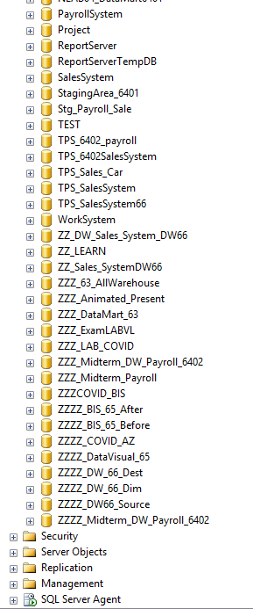
การสร้าง JOB ที่เรียกใช้งาน Stored Procedure
1. Click
https://www.atlasprecon.com/create-sql-job-run-stored-procedure/?fbclid=IwAR3C-PaarUdXmfrVNo4O7v_-OVBuGkgKjd_z4X_JwMpEJuhedFU6lA2DRMo
https://km.phuket.psu.ac.th/archives/3858

Slide 15
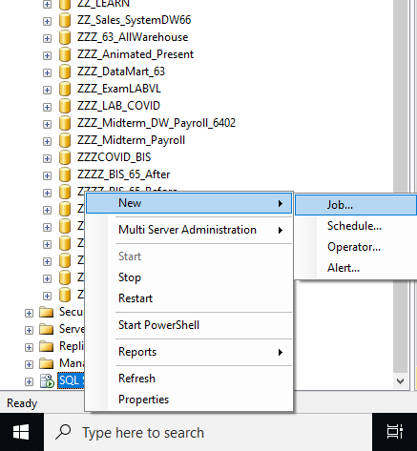
2. New>Job

Slide 16
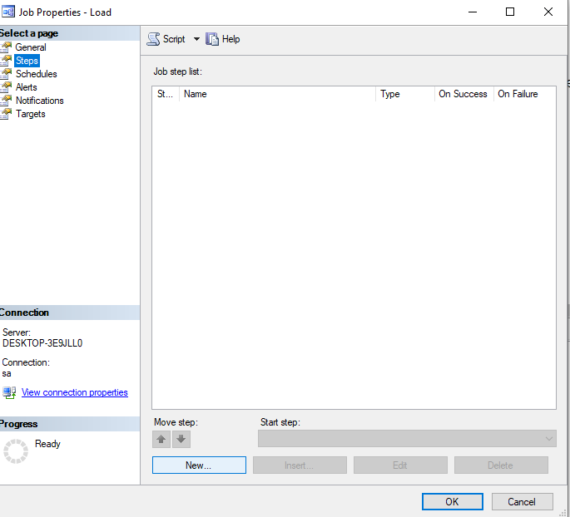
3. Step >new

Slide 17
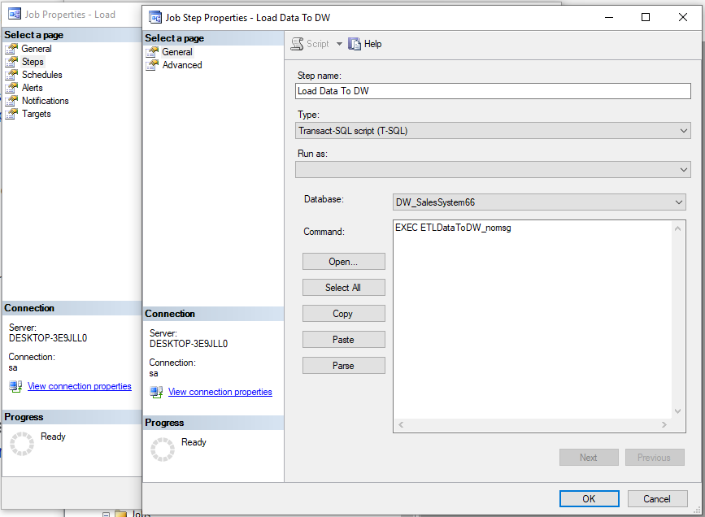
ใส่ Step name

Slide 18
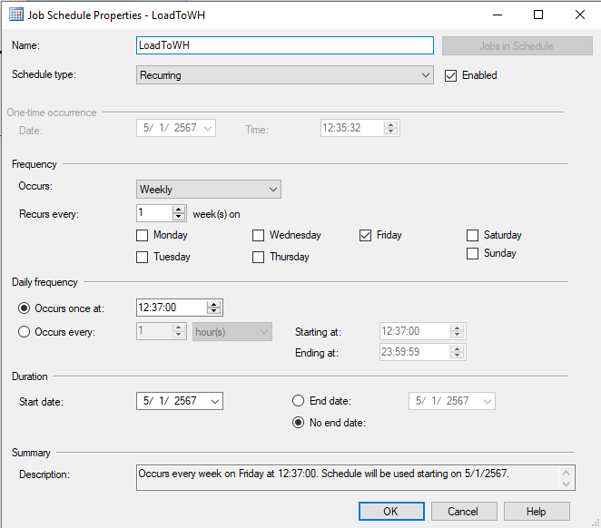
4. Job Schedule

Slide 19
ตัวอย่างในห้อง LAB

Slide 20
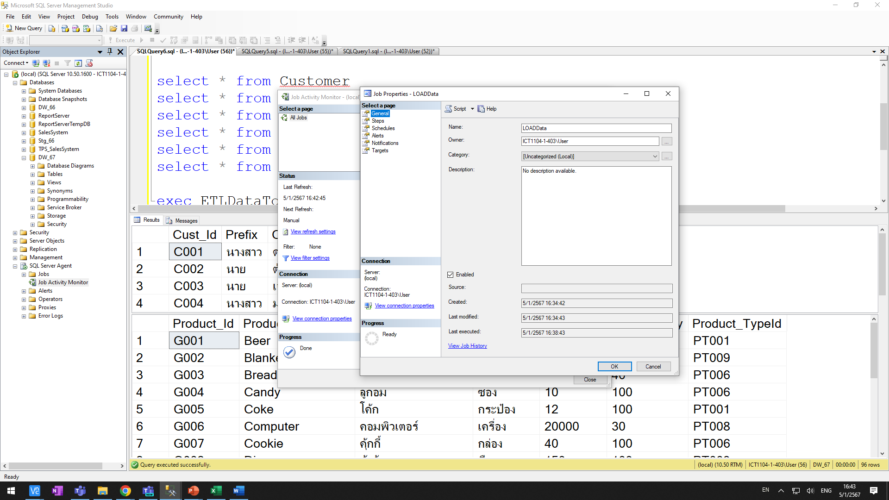
1. New job ใส่ชื่อ LOADData (อย่าเพิ่งกด OK)
2. จากนั้น Click Steps

Slide 21
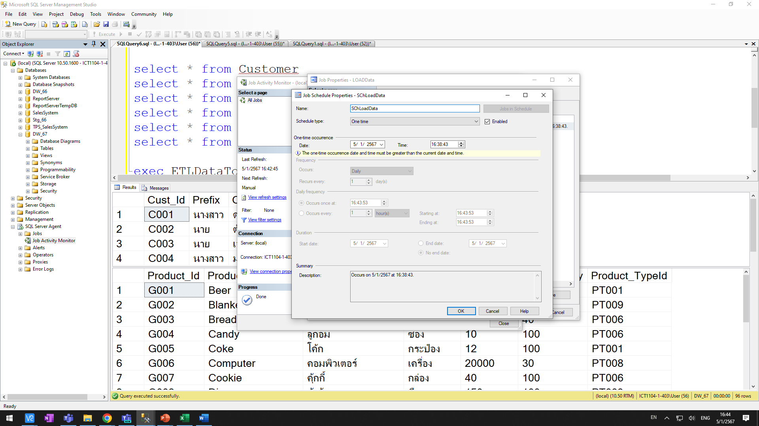

Slide 22
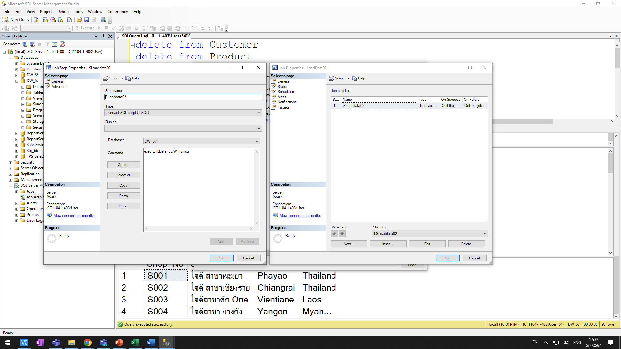
กำหนดค่าใน Step

Slide 23
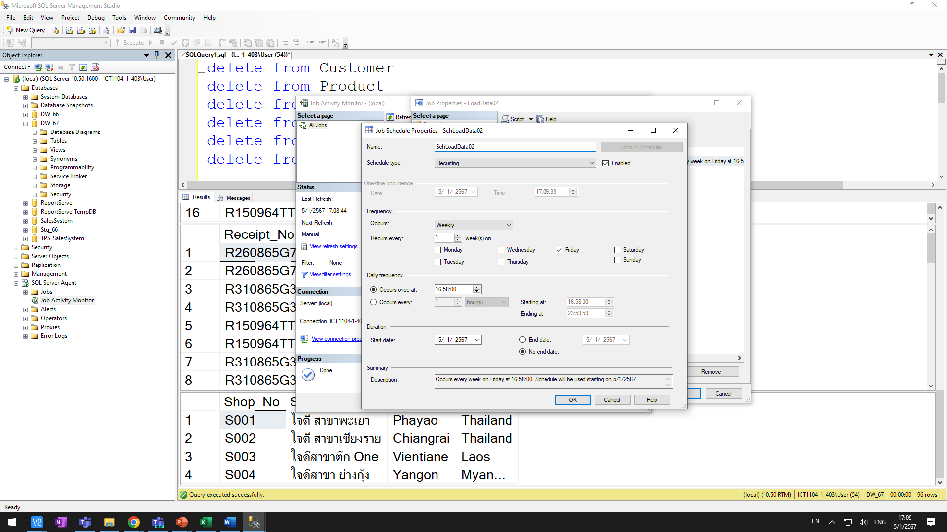
กำหนดค่าใน Schedule

