Slide 1
Storytelling with Data
4.7 pulling it all together
โดย สุรินทร์ทิพ ศักดิ์ภูวดล

Slide 2
6 Step of story telling with data
1. Understand the context (Chapter 4.1)
2. Choose an appropriate display (Chapter4.2)
3. Eliminate clutter (Chapter 4.3)
4. Draw attention where you want it (Chapter 4.4)
5. Think like a designer (Chapter 4.5)
6. Tell a story (Chapter 4.7)

Slide 3
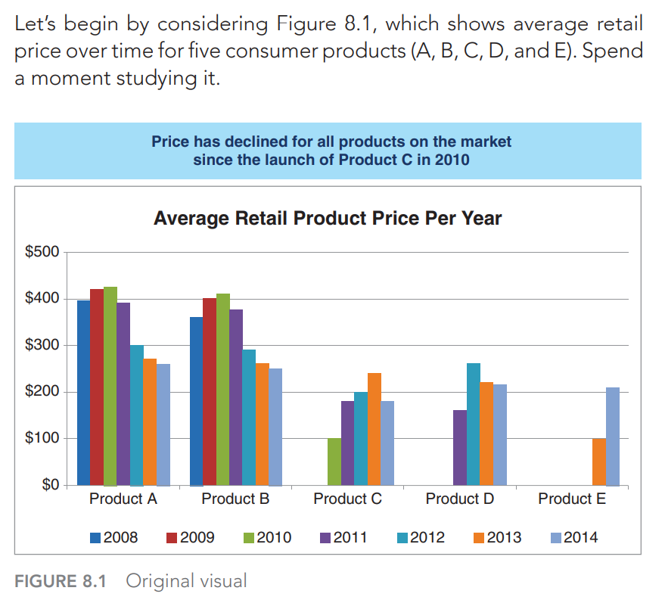
Original Visual (Visual ที่ยังไม่ดีพอใช้หลักแก้ไขให้ดีขึ้น)

Slide 4
1. Understand the context
If we pause to consider specifically the who, what, and how, let’s assume following:
Who: VP of Product, the primary decision maker in establishing our product’s price.
What: Understand how competitors’ pricing has changed over time and recommend a price range.
How: Show average retail price over time for Products A, B, C, D, and E

Slide 5
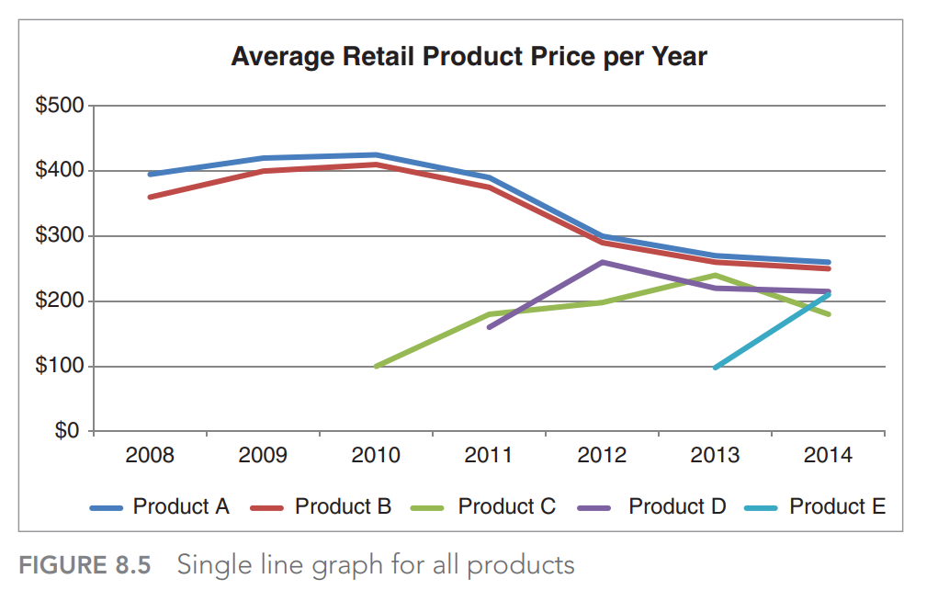
2. Choose an appropriate display

Slide 6
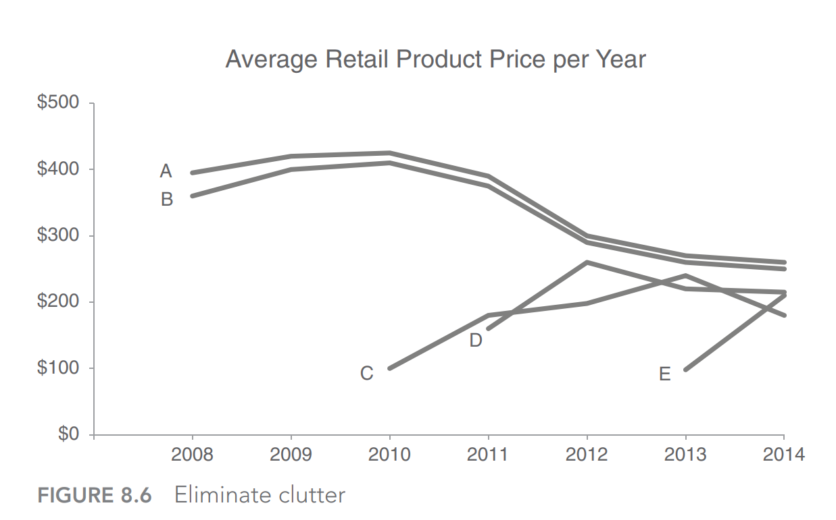
3: eliminate clutter

Slide 7
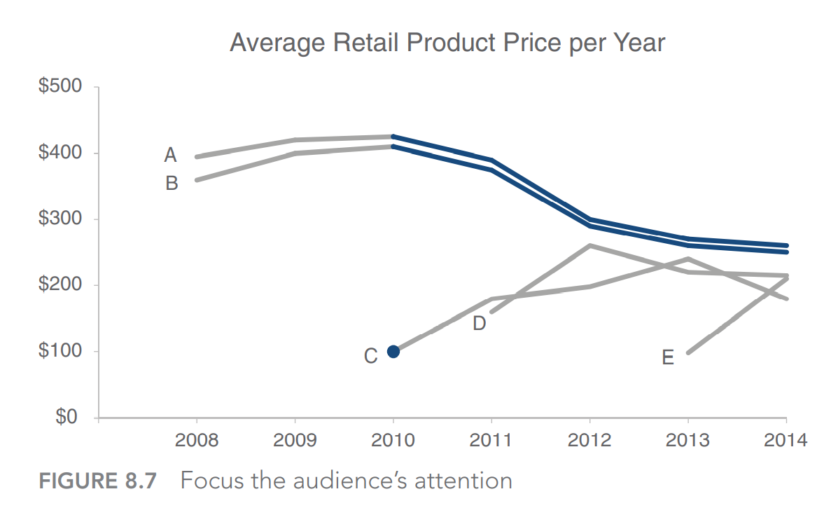
4: draw attention where you want your audience to focus

Slide 8
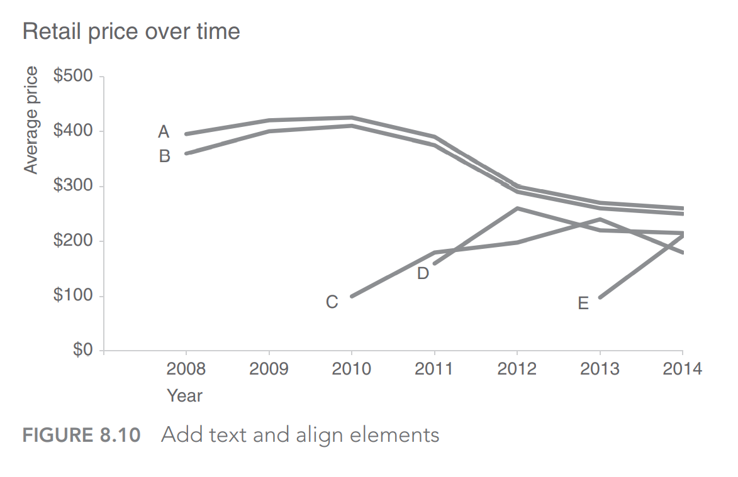
5: think like a designer

Slide 9
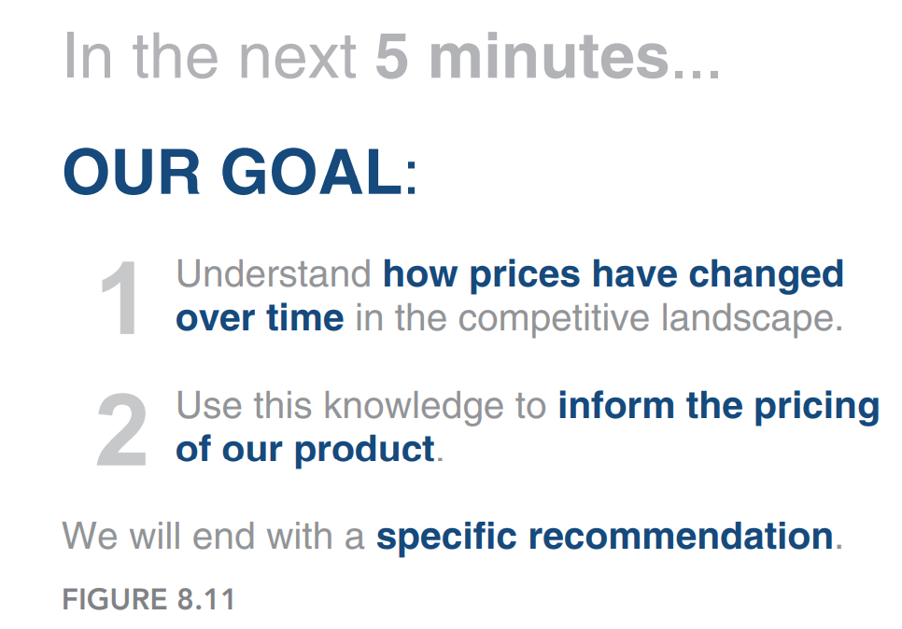
6: tell a story

Slide 10
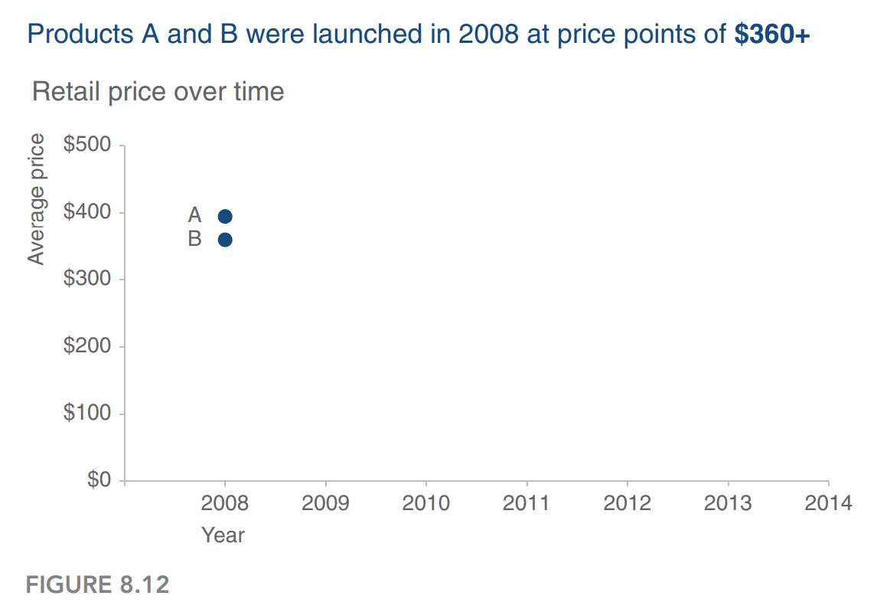
6: tell a story

Slide 11
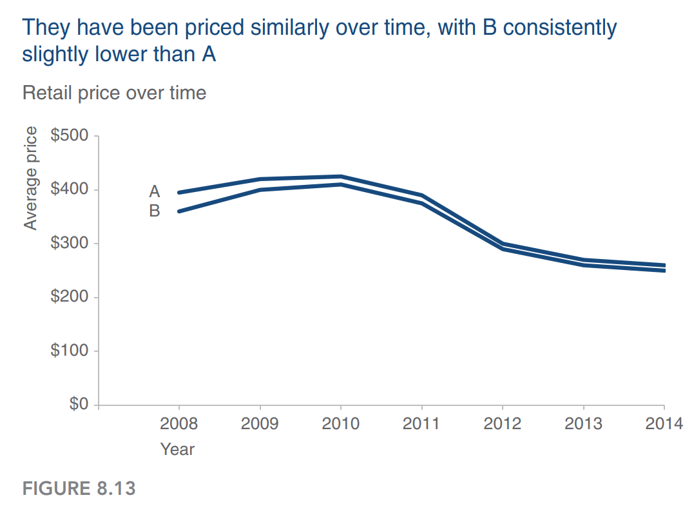
6: tell a story

Slide 12
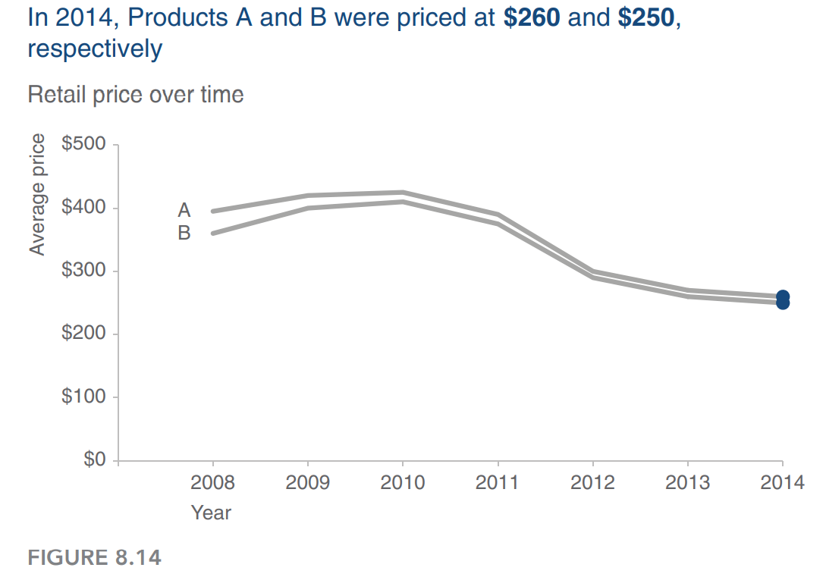
6: tell a story

Slide 13
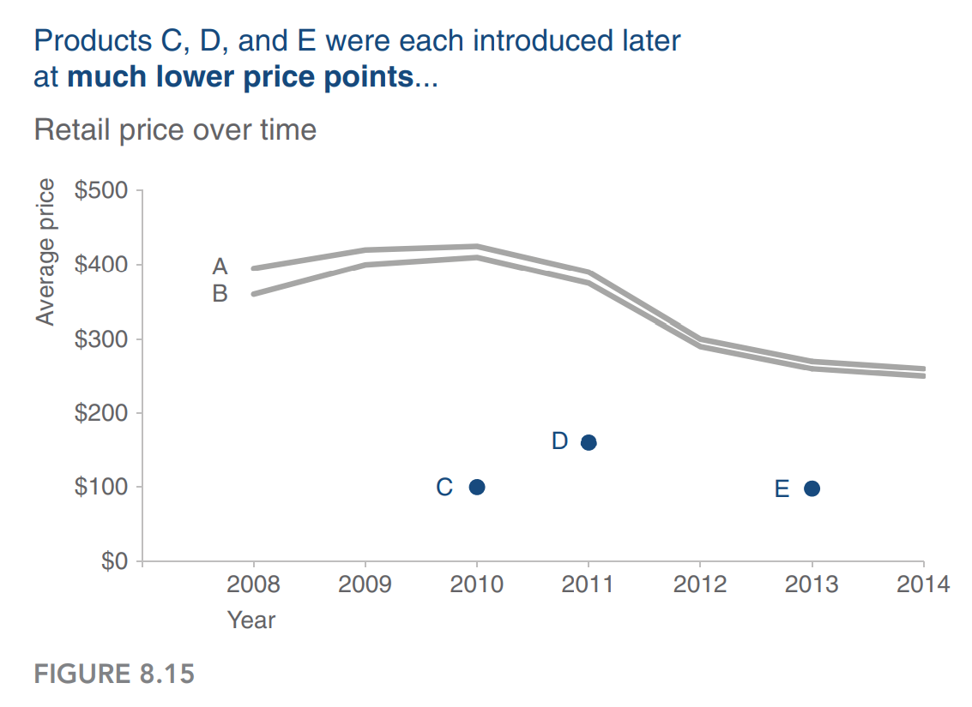
6: tell a story

Slide 14
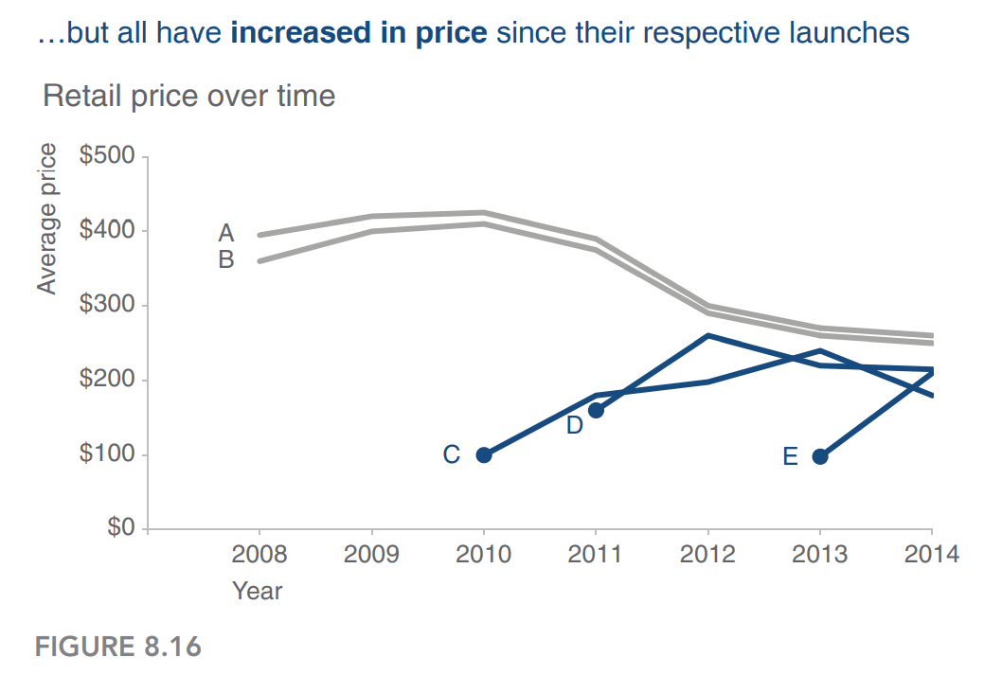
6: tell a story

Slide 15
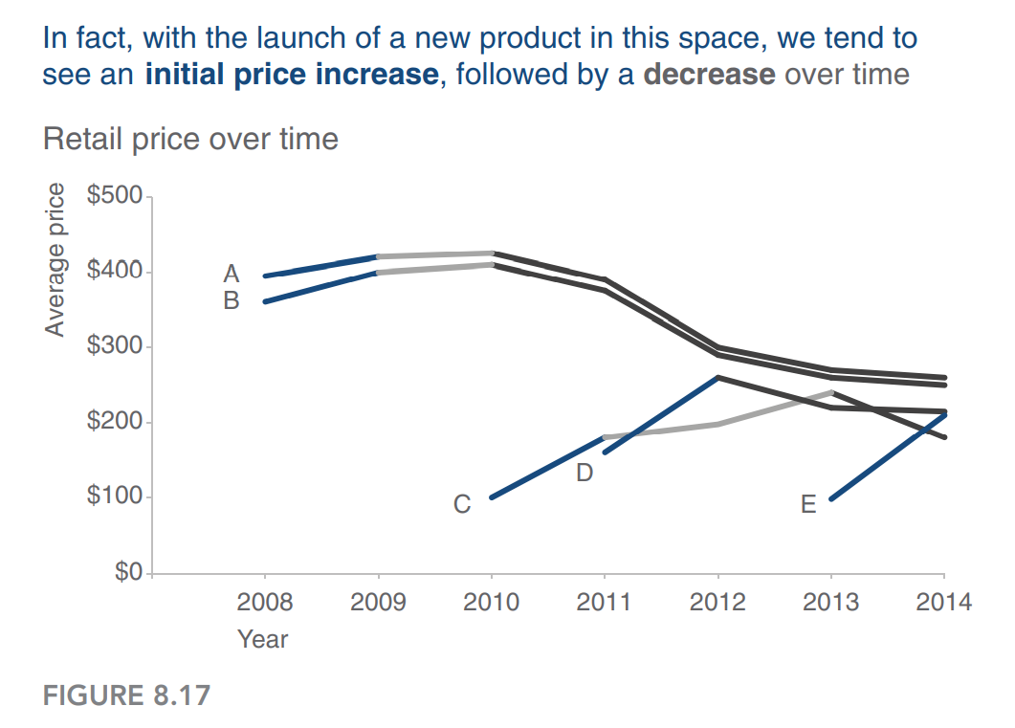
6: tell a story

Slide 16
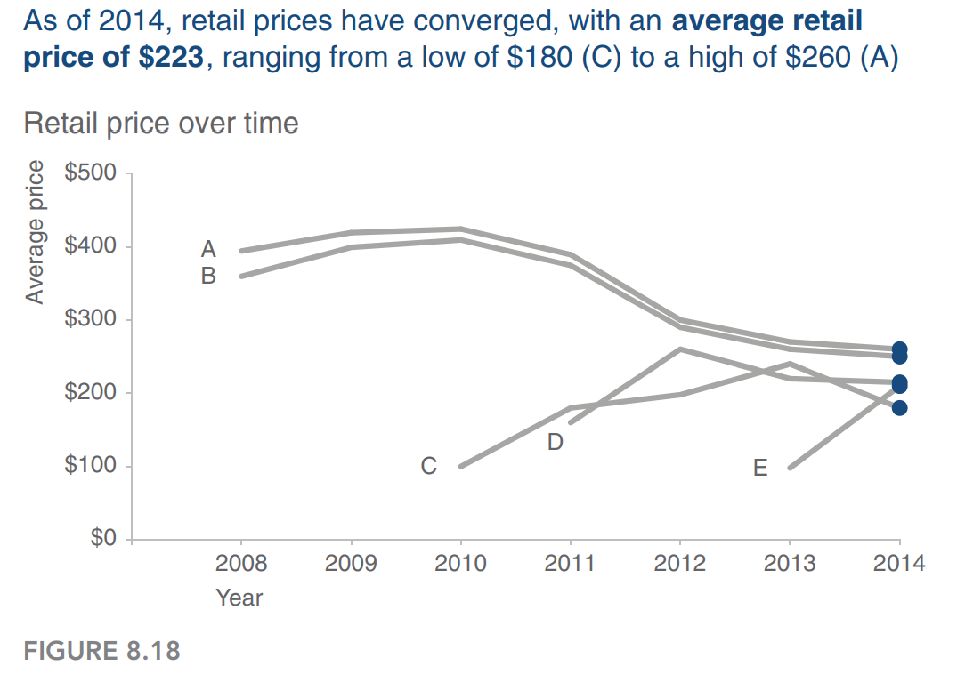
6: tell a story

Slide 17
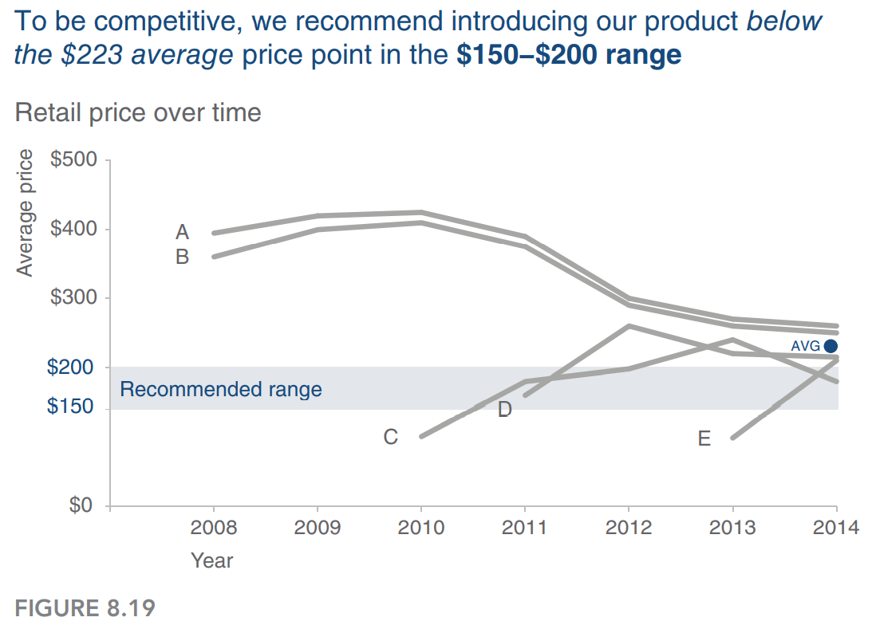
6: tell a story

Slide 18
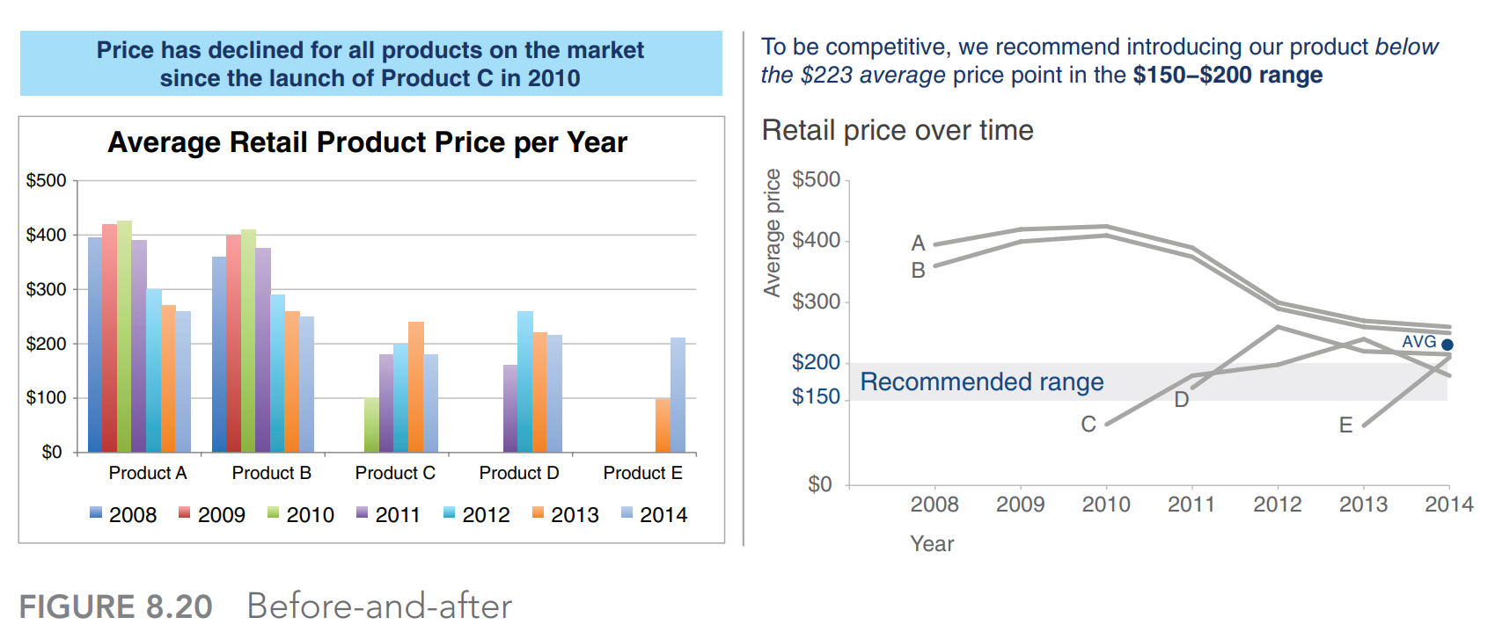
The lessons we’ve learned and employed help us move from simply showing data to storytelling with data
6: Before and after graph using data story telling concept
ยังไม่ใช้หลักการ storytelling with data
ใช้หลักการ storytelling with data

