Slide 1
PowerBI
การหา TOP 5

Slide 2
การแสดง Top 5

Slide 3
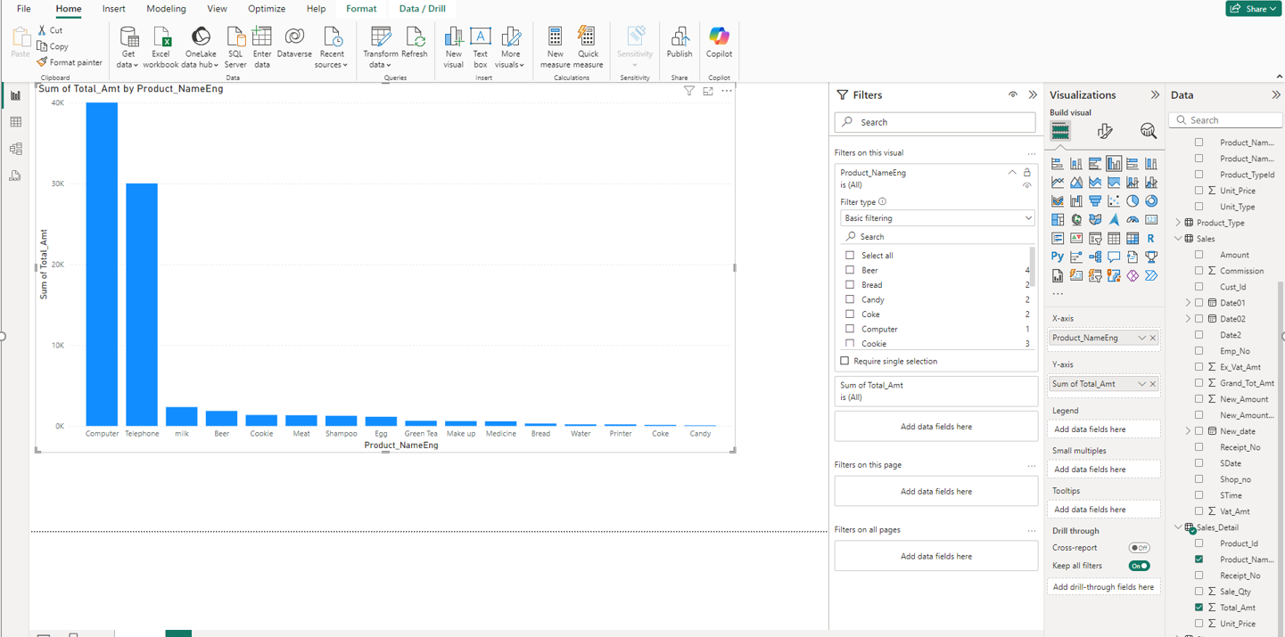
1. Click Filter on this visual
https://www.youtube.com/watch?v=cp7ruGDu5GU

Slide 4
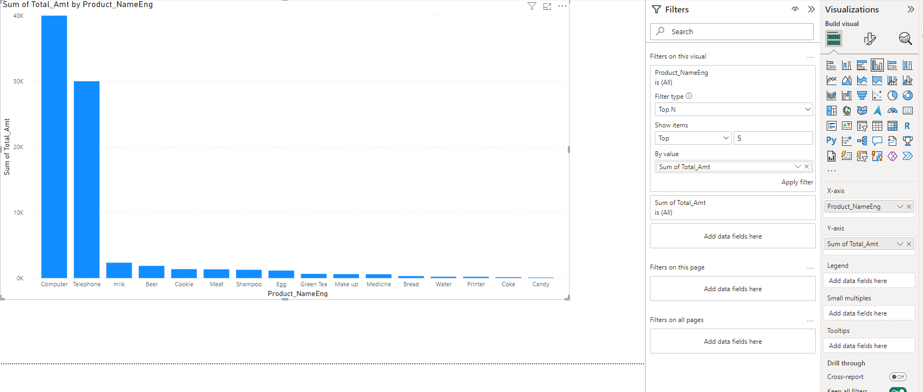
2. เลือก Filter type = Top N 3. Show items = Top 5 4. By value = Sum of Total_Amt 5. Click Apply filter

Slide 5
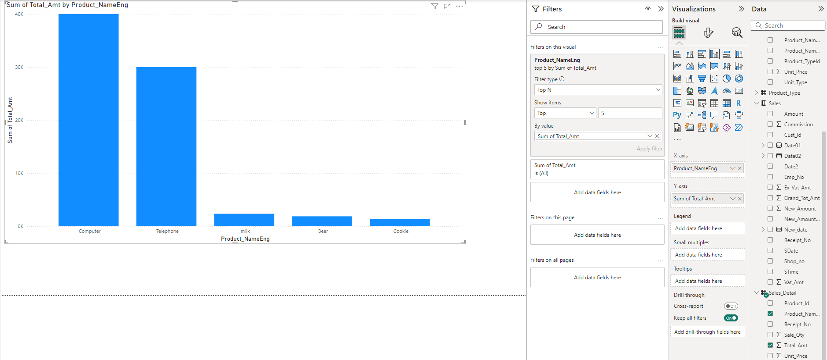
จะได้ Result ตามภาพ

Slide 6
https://www.youtube.com/watch?v=k8rUyh2_BA8 2. https://www.youtube.com/watch?v=G8ikAJele_s 3. https://www.youtube.com/watch?v=Erfn70RwqD0 4. https://www.youtube.com/watch?v=G8ikAJele_s 5. https://www.youtube.com/watch?v=QHx5Sdo5BcA 6. https://www.youtube.com/watch?v=G8ikAJele_s

Slide 7
https://www.youtube.com/watch?v=NNSHu0rkew8
https://www.youtube.com/watch?v=cYwioeHu_OU

