Slide 1
SQL Command
#03
จัดทำโดย
สุรินทร์ทิพ ศักดิ์ภูวดล
คณะ ICT มหาวิททยาลัยพะเยา

Slide 2
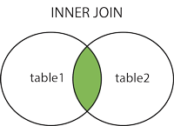
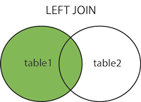
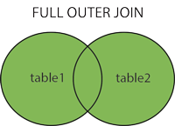
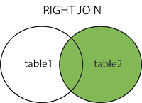
Different Types of SQL JOINs

Slide 3
INNER JOIN
The INNER JOIN keyword selects records that have matching values in both tables. (จะเลือกแสดงข้อมูลที่ตรงกันทั้ง 2 table)
SELECT column_name(s)
FROM table1
INNER JOIN table2
ON table1.column_name = table2.column_name;
SELECT *
FROM color
INNER JOIN sales_car
ON color.color_id = sales_car.color_id
SELECT sales_car.sale_id,sales_car.sale_id,
sales_car.color_id,color.Color_desc
FROM color
INNER JOIN sales_car
ON color.color_id = sales_car.color_id

Slide 4
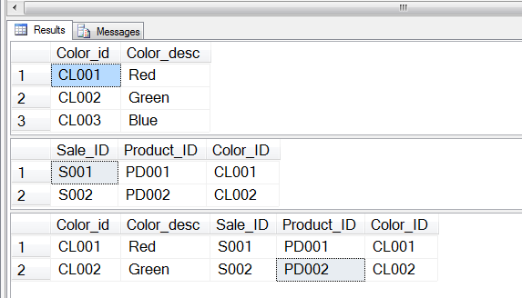
INNER JOIN
select * from Color
select * from sales_car
SELECT *
FROM color
INNER JOIN sales_car
ON color.color_id = sales_car.color_id

Slide 5
LEFT JOIN
The LEFT JOIN keyword returns all records from the left table (table1), and the matched records from the right table (table2). The result is NULL from the right side, if there is no match. แสดงข้อมูลที่อยู่ทางซ้าย (คือ table1) เป็นหลัก
SELECT column_name(s)
FROM table1
LEFT JOIN table2
ON table1.column_name = table2.column_name;
SELECT *
FROM color
LEFT JOIN sales_car
ON color.color_id = sales_car.color_id
SELECT sales_car.sale_id,sales_car.sale_id, sales_car.color_id,color.Color_desc
FROM color
LEFT JOIN sales_car
ON color.color_id = sales_car.color_id

Slide 6
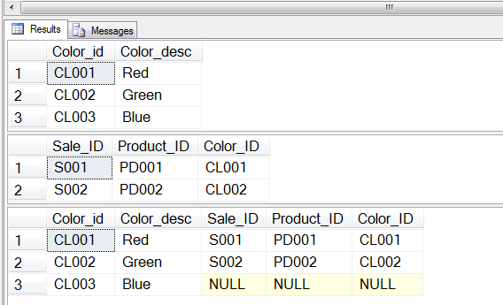
LEFT JOIN
select * from Color
select * from sales_car
SELECT *
FROM color
LEFT JOIN sales_car
ON color.color_id = sales_car.color_id

Slide 7
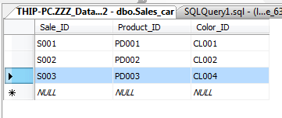
Add Data (S003)

Slide 8
RIGHT JOIN
The RIGHT JOIN keyword returns all records from the right table (table2), and the matched records from the left table (table1). The result is NULL from the left side, when there is no match. แสดงข้อมูลที่อยู่ทางขวา (คือ table2) หลังคำว่า Right join เป็นหลัก
SELECT column_name(s)
FROM table1
RIGHT JOIN table2
ON table1.column_name = table2.column_name;
SELECT *
FROM color
RIGHT JOIN sales_car
ON color.color_id = sales_car.color_id
SELECT sales_car.sale_id,sales_car.sale_id,
sales_car.color_id,color.Color_desc
FROM color
RIGHT JOIN sales_car
ON color.color_id = sales_car.color_id

Slide 9
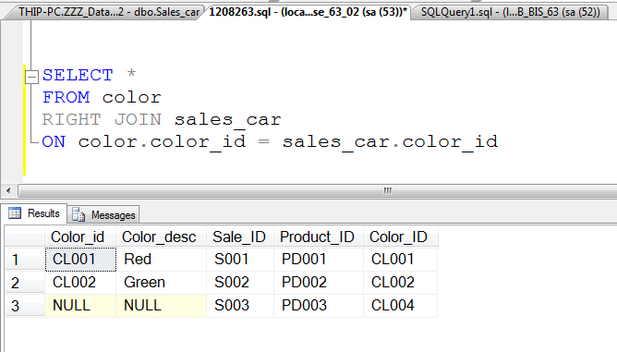
RIGHT JOIN

Slide 10
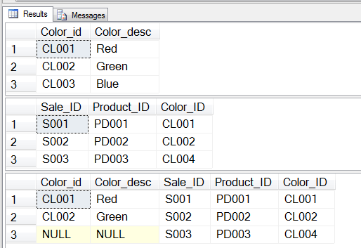
RIGHT JOIN
select * from Color
select * from sales_car
SELECT *
FROM color
RIGHT JOIN sales_car
ON color.color_id = sales_car.color_id

Slide 11
FULL OUTER JOIN
The FULL OUTER JOIN keyword returns all records when there is a match in left (table1) or right (table2) table records. (นำข้อมูลมาหมด)
SELECT column_name(s)
FROM table1
FULL OUTER JOIN table2
ON table1.column_name = table2.column_name
WHERE condition;

Slide 12
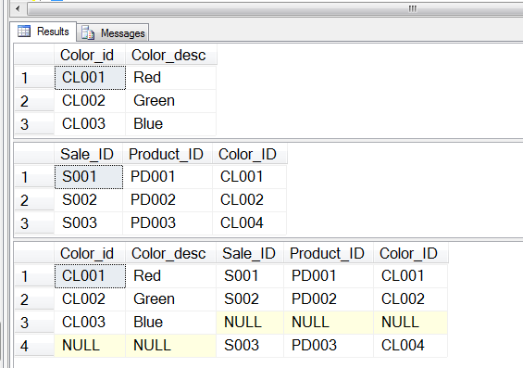
FULL OUTER JOIN
select * from Color
select * from sales_car
SELECT *
FROM color
FULL OUTER JOIN sales_car
ON color.color_id = sales_car.color_id

Slide 13
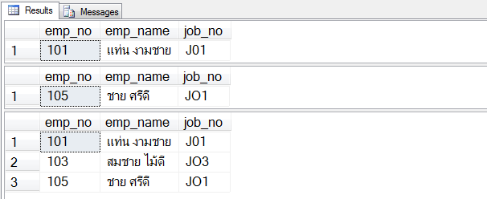
LIKE
select emp_no,emp_name,job_no from Employee
where Emp_Name like'%ชาย‘ ลงท้ายด้วยคำว่า “ชาย”
select emp_no,emp_name,job_no from Employee
where Emp_Name like'ชาย%‘ นำหน้าด้วยคำว่า “ชาย”
select emp_no,emp_name,job_no from Employee
where (Emp_Name like'%ชาย%') คำว่า “ชาย” อยู่ตำแหน่งใดก็ได้

Slide 14
Reference :
https://www.w3schools.com/sql/

