Slide 1
Animated Bar Chart (Power Bi)
สุรินทร์ทิพ ศักดิ์ภูวดล

Slide 2
Excel File ชื่อ LAB0222
insert into COVID_Report
select Announce_date,province_of_onset,COUNT(Announce_date) C_Num from covid_clean
group by Announce_date,province_of_onset order by province_of_onset
select * from covid_clean where Announce_date = '2022-01-07 00:00:00.000'
and province_of_onset='USA'

Slide 3
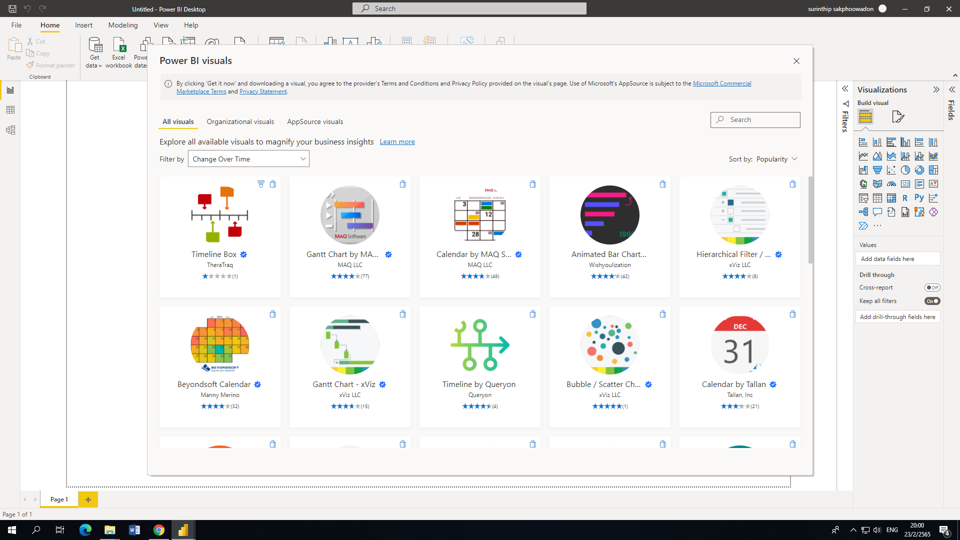
เลือก …Time, Change over time ขึ้นกับ Version จากนั้นเลือก Animated bar chart

Slide 4
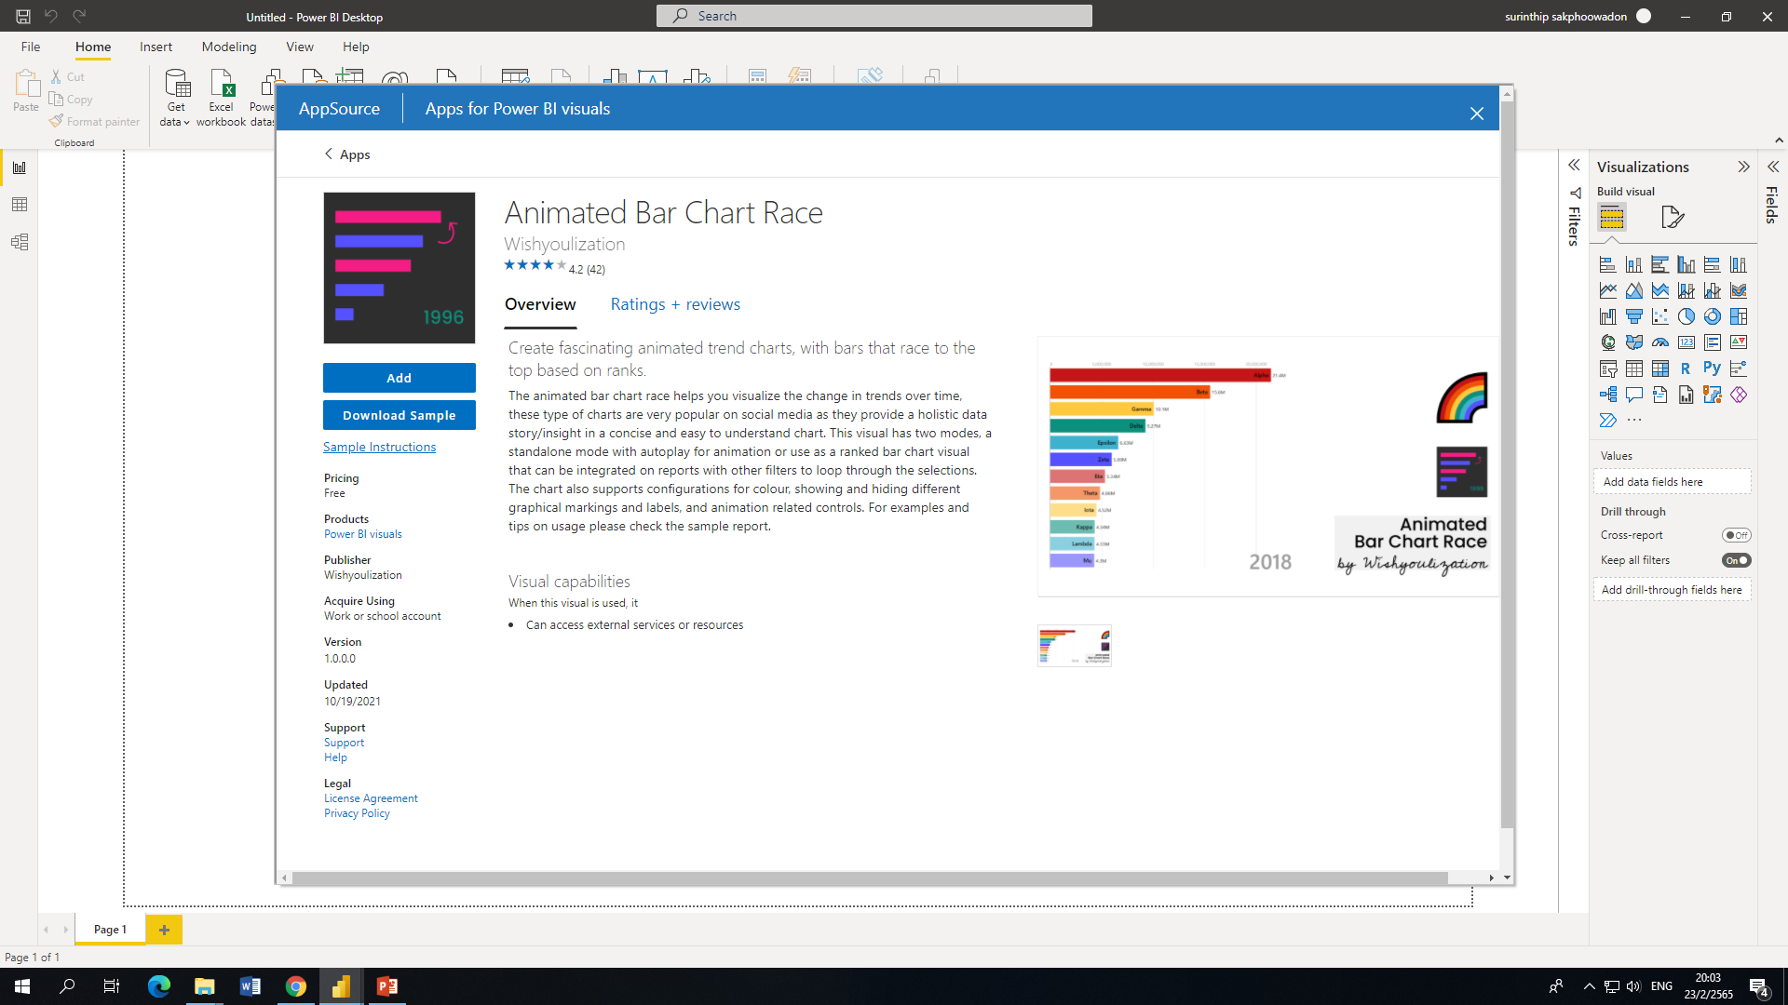
Click Add

Slide 5
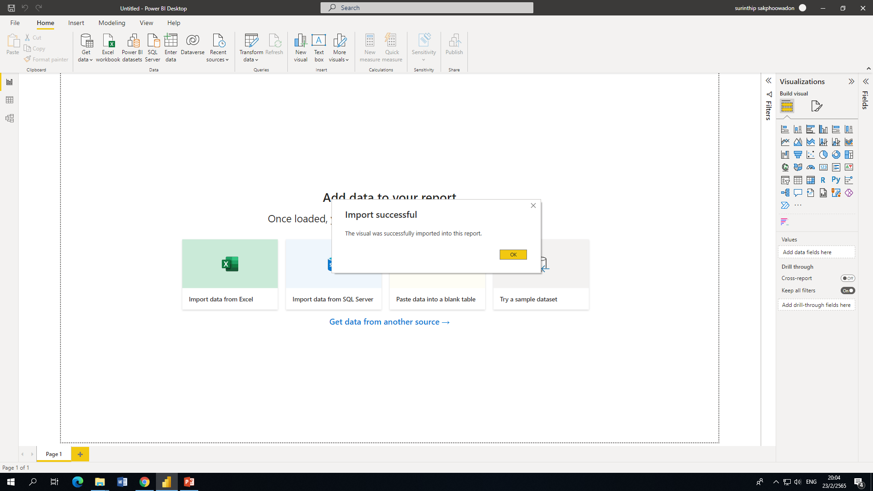
Then the program will show

Slide 6
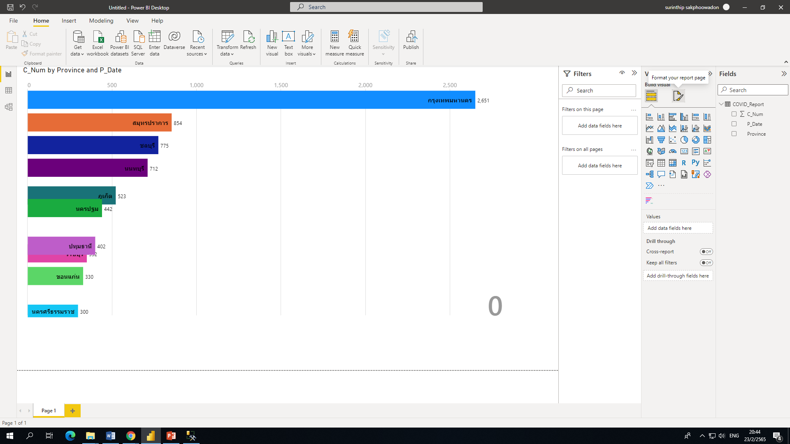
Format

Slide 7
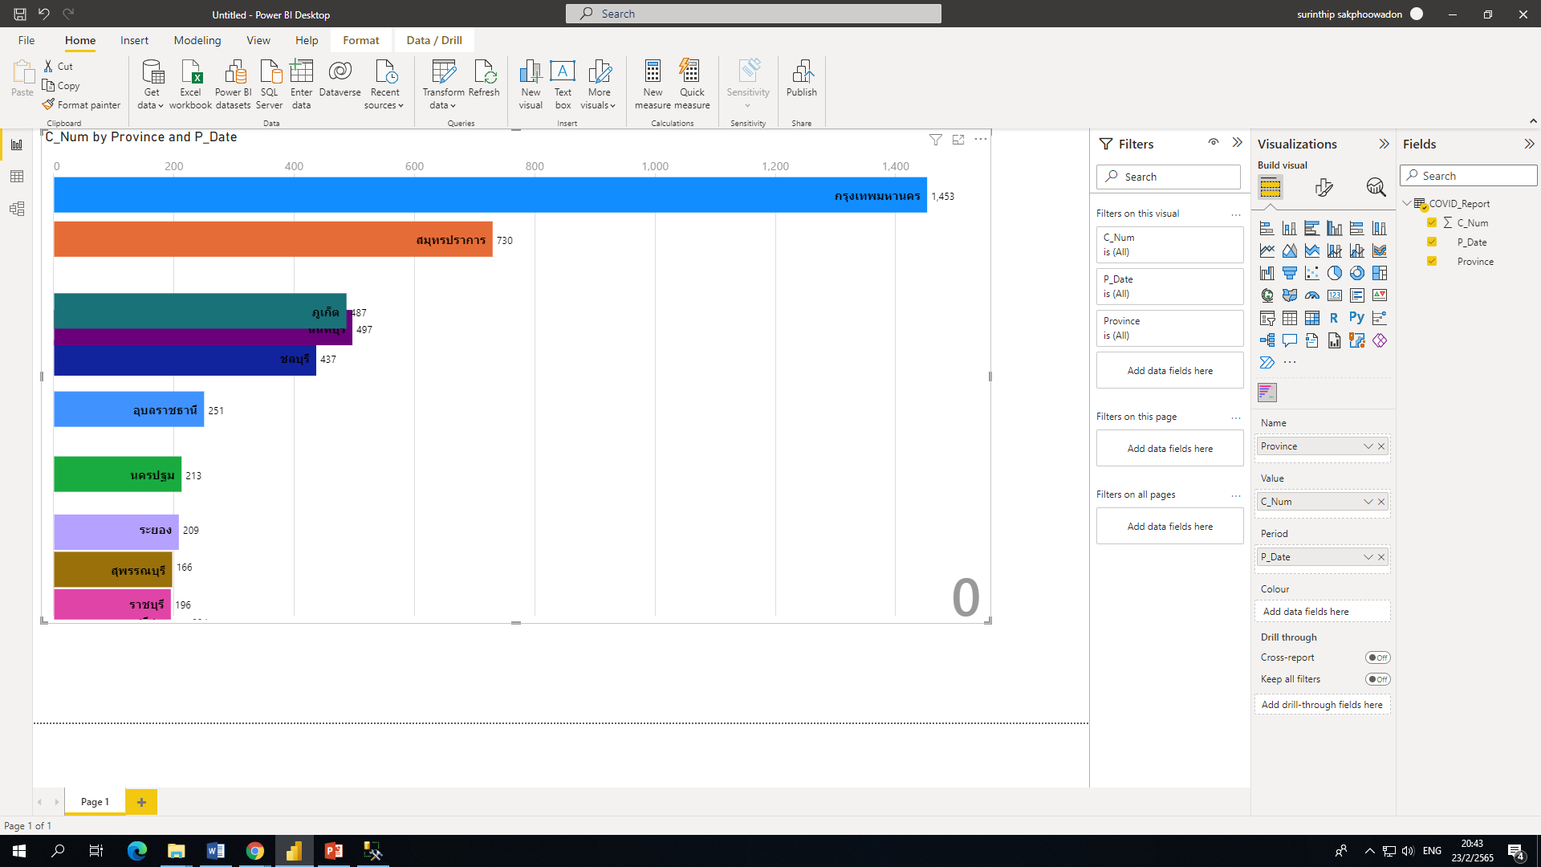

Slide 8
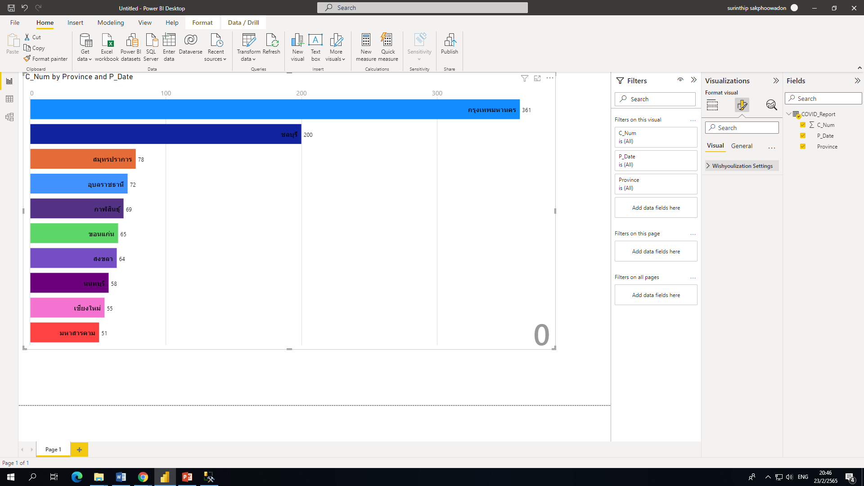
Wishyoulization Setting

Slide 9
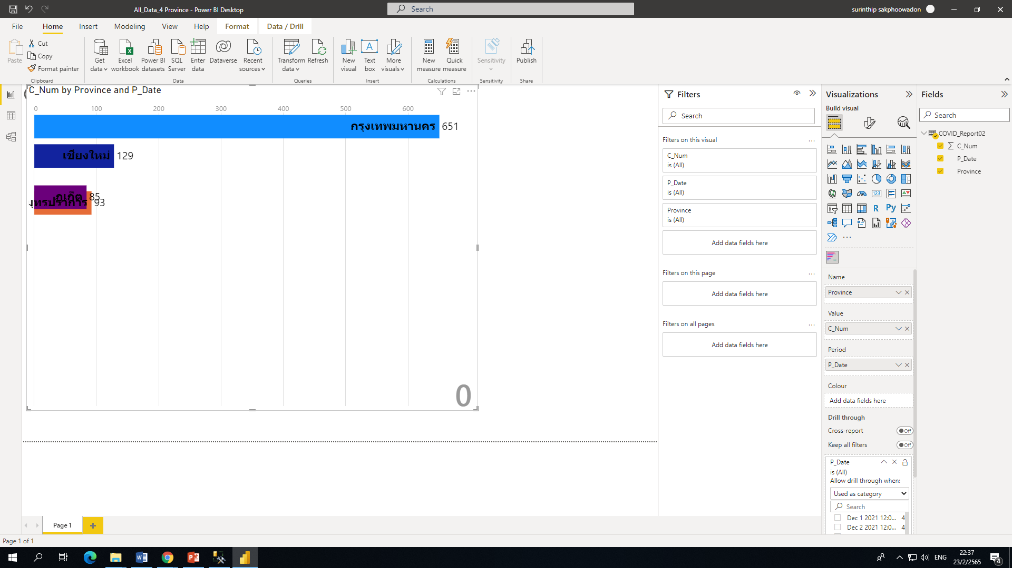
Data 4 จังหวัด

Slide 10
Code
insert into COVID_Report
select Announce_date,province_of_onset,COUNT(Announce_date) C_Num from covid_clean
group by Announce_date,province_of_onset order by province_of_onset
select * from covid_report
select * from covid_clean where Announce_date = '2022-01-07 00:00:00.000'
and province_of_onset='USA'
select * from covid_clean where Announce_date = '2022-01-07 00:00:00.000'
and province_of_onset='พะเยา'
select * from covid_report where P_date = 'Jan 7 2022 12:00AM'
and province='พะเยา'

Slide 11
Code
insert into covid_report02
select * from covid_report where Province ='กรุงเทพมหานคร' and P_Date <= 'Dec 10 2021 12:00AM'
insert into covid_report02
select * from covid_report where Province ='สมุทรปราการ' and P_Date <= 'Dec 10 2021 12:00AM'
insert into covid_report02
select * from covid_report where Province ='ภูเก็ต' and P_Date <= 'Dec 10 2021 12:00AM'
insert into covid_report02
select * from covid_report where Province ='เชียงใหม่' and P_Date <= 'Dec 10 2021 12:00AM'
select * from covid_report02 order by P_date,C_num desc

