Slide 1
Chapter 01
Introduction to Business Intelligence
โดย สุรินทร์ทิพ ศักดิ์ภูวดล

Slide 2
Business Intelligence
By 2000, Information Democracy will emerge in forward-thinking enterprises, with Business Intelligence information and applications available broadly to employees, consultants, customers, suppliers, and the public. The key to thriving in a competitive marketplace is staying ahead of the competition. Making sound business decisions based on accurate and current information takes more than intuition. Data analysis, reporting, and query tools can help business users wade through a sea of data to synthesize valuable information from it — today these tools collectively fall into a category called “Business Intelligence. (Bert Brijs,pp5)

Slide 3
Business intelligence (BI)
Business intelligence (BI) is a broad category of applications and technologies for gathering, storing, analyzing, and providing access to data to help enterprise users make better business decisions. (Bert Brijs,2013)
Using a broad definition: “Business Intelligence is a set of methodologies, processes, architectures, and technologies that transform raw data into meaningful and useful information used to enable more effective strategic, tactical, and operational insights and decision-making.” Under this definition, business intelligence also includes technologies such as data integration, data quality, data warehousing, master-data management, text- and content-analytics, and many others that the market sometimes lumps into the “Information Management” segment. (Drew Bentley ,2017)

Slide 4
BI applications
BI applications include the activities of decision support systems, query and reporting, online analytical processing (OLAP), statistical analysis, forecasting, and data mining.
Business intelligence applications can be:
• Mission-critical and integral to an enterprise’s operations or occasional to meet a special requirement
• Enterprise wide or local to one division, department, or project
• Centrally initiated or driven by user demand

Slide 5
ระบบธุรกิจอัจฉริยะ
Business Intelligence is a set of methodologies, processes, architectures, and technologies that transform raw data into meaningful and useful information used to enable more effective strategic, tactical, and operational insights and decision-making. (Drew Bentley ,2017)
ระบบธุรกิจอัจฉริยะคือชุดของวิธีการ กระบวนการ สถาปัตยกรรม และเทคโนโลยีที่แปลงข้อมูลดิบให้เป็นสารสนเทศที่มีความหมายและมีประโยชน์ เพื่อนำไปใช้ในการสร้างกลยุทธ์ ยุทธวิธี และการดำเนินงาน และช่วยสนับสนุนการตัดสินใจให้มีประสิทธิภาพมากขึ้น

Slide 6
BI applications ประกอบด้วย
1. decision support systems (DSS ระบบสนับสนุนการตัดสินใจ)
2. query and reporting (การสอบถามและทำรายงาน)
3. online analytical processing (OLAP) การประมวลผลเชิงวิเคราะห์แบบออนไลน์
4. statistical analysis (การวิเคราะห์ทางสถิติ)
5. data mining (การทำเหมืองข้อมูล)
(Clustering, classification (Prediction, forecasting), association)

Slide 7
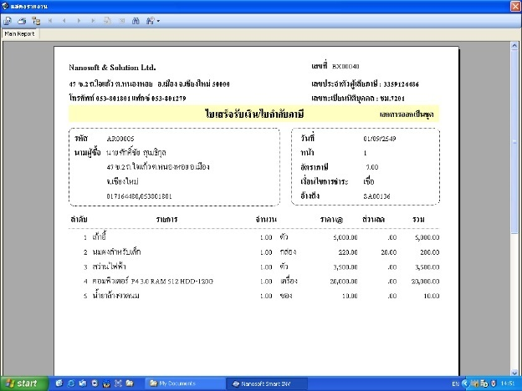
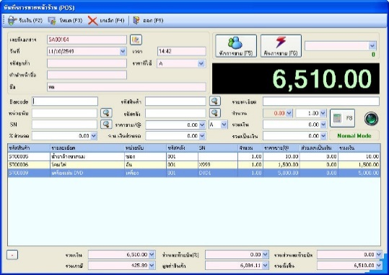
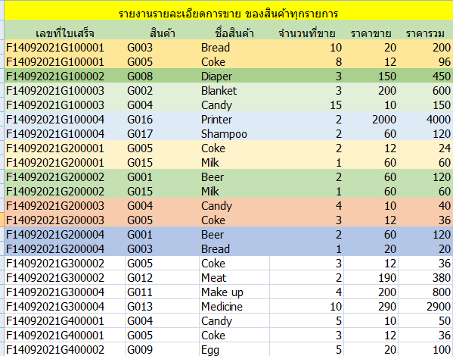
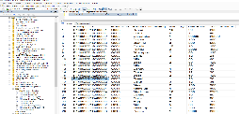
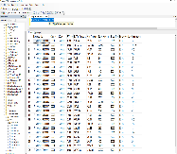
Point of sales
Point of sales System

Slide 8
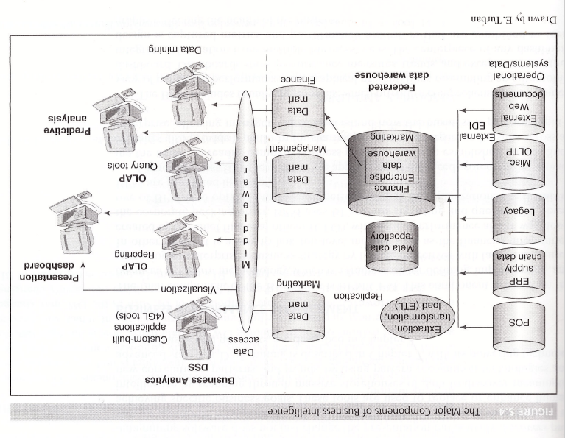
The Major Components of Business Intelligence

Slide 9
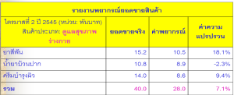
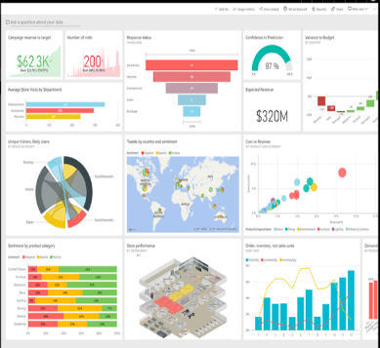

Data Source
Data for Analysis
Technique
User
Operation Data
Historical Data
เช่น
ERP
CRM
Payroll
Point of sales
Data warehouse
Data mart
Historical Data
Query and Report
OLAP
Data mining
Data Visualization
USER
Data Access
ETL
DW
DM
DM
DM
DM
External Data
Business intelligence architecture

Slide 10
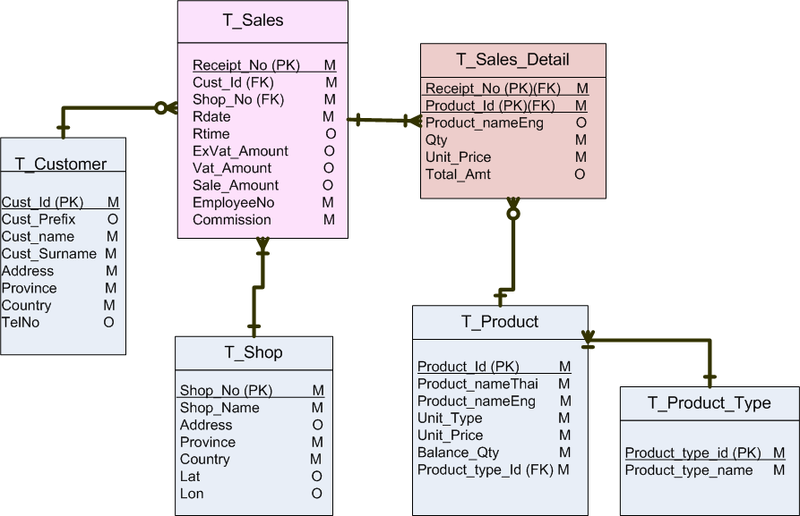
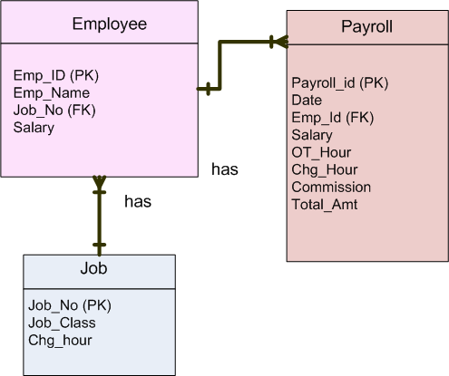
Data Source
Data Warehouse,
Data Mart
USER
Tps Database: Sales system
MIS, DSS, ESS Database
Tps Database: Payroll system

Slide 11
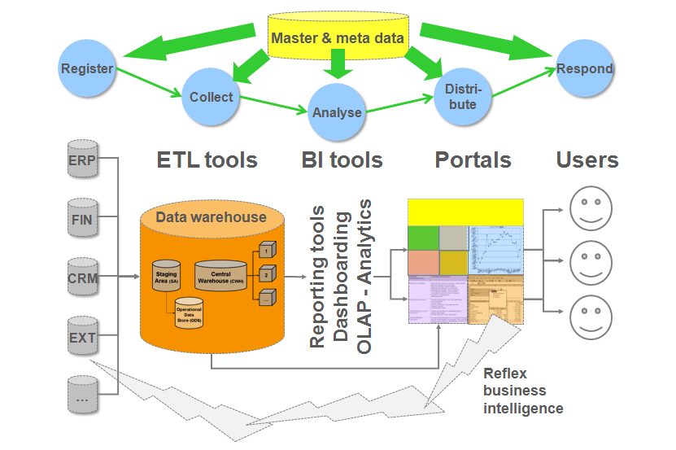
The different components of BI architecture
https://enterprizeea.files.wordpress.com/2014/06/bi-business-intelligence-and-data-warehouse.png
https://www.researchgate.net/figure/A-Typical-architecture-of-business-intelligence-and-data-sources-to-create-data-warehouse_fig2_281278975

Slide 12
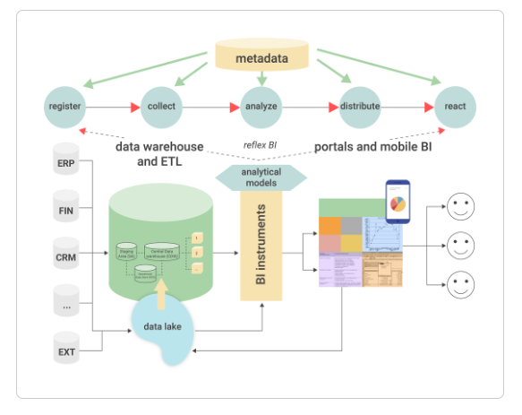
The different components of BI architecture
https://www.passionned.com/bi/architecture/

Slide 13
BI Reporting Tool
Integrate.io
IBM Cognos
Micro Strategy
Palo OLAP Server
Apache Kylin
icCube
Pentaho BI
Mondrian
OBIEE
JsHypercube
Jedox

Slide 14
Reference
Business Analysis for Business Intelligence, Bert Brijs, 2013

