Slide 1
Data warehouse

Slide 2
การ load จาก Data Staging area ไป Data warehouse
Data staging area
Data warehouse

Slide 3
ให้นิสิตลองคิดดู
Import แบบย้ายข้าม Database ใช้ Software ยกเว้น
Table Sales, Customer

Slide 4
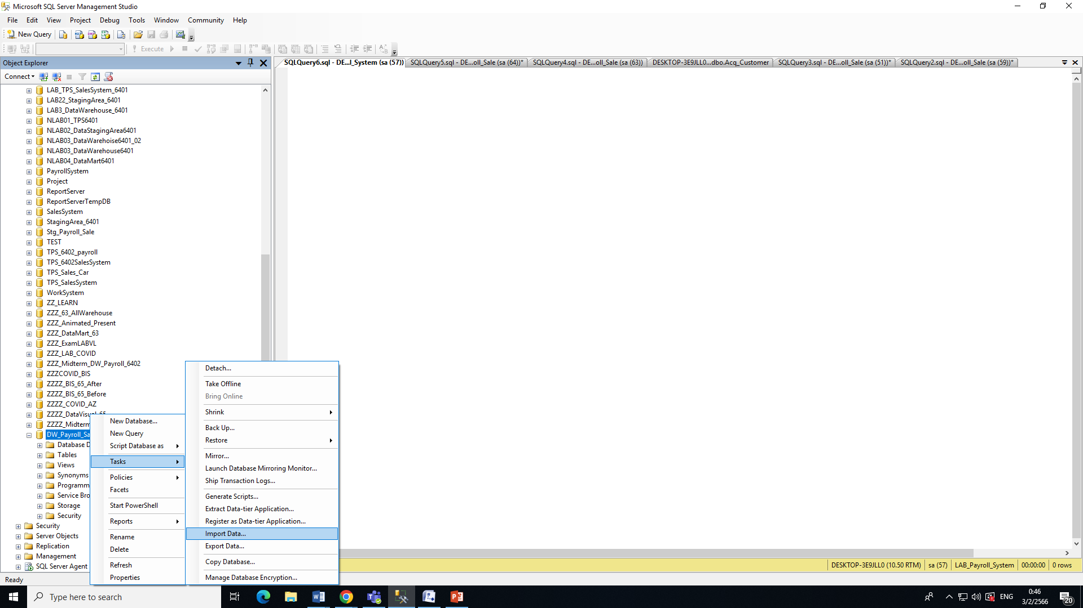
Import จากStg_Payroll_Saleไปยัง DW_Payroll_Sale

Slide 5
Table Sale กับ Customer
CREATE TABLE [dbo].[DW_Sales](
[Receipt_No] [nvarchar](20) NOT NULL,
[Cust_Id] [nvarchar](10) NULL,
[SDate] [nvarchar](10) NULL,
[Ex_Vat_Amt] [float] NULL,
[Vat_Amt] [float] NULL,
[Grand_Tot_Amt] [float] NULL,
[Shop_no] [nvarchar](50) NULL,
[Emp_No] [nvarchar](20) NULL,
[Commission] [float] NULL
) ON [PRIMARY]
GO
insert into DW_Payroll_Sale.dbo.DW_Sales(Receipt_No,Cust_Id,SDate,Ex_Vat_Amt,
Vat_Amt,Grand_Tot_Amt,Shop_no,Emp_No,Commission)
select Receipt_No,Cust_Id,SDate,Ex_Vat_Amt,Vat_Amt,Grand_Tot_Amt,Shop_no,Emp_No,Commission
from Stg_Payroll_Sale.dbo.Stg_Sales

Slide 6
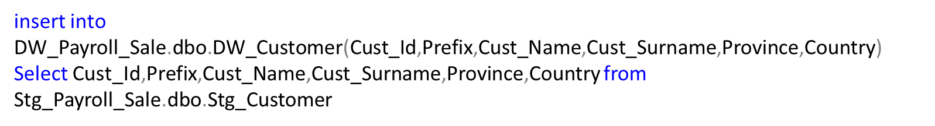
Customer
CREATE TABLE [dbo].[DW_Customer](
[Cust_Id] [nvarchar](20) NOT NULL,
[Prefix] [nvarchar](20) NULL,
[Cust_Name] [nvarchar](50) NULL,
[Cust_Surname] [nvarchar](60) NULL,
[Province] [nvarchar](50) NULL,
[Country] [nvarchar](50) NULL
) ON [PRIMARY]
GO

